Slide 1
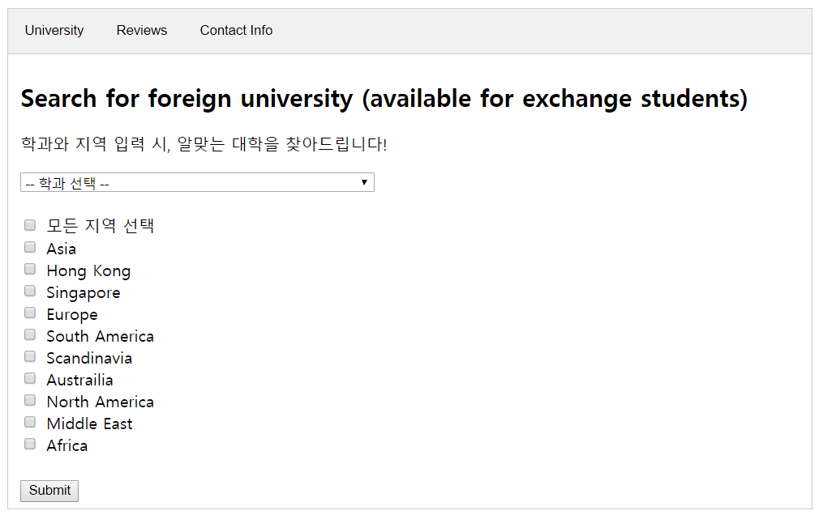
HOEP:
KAIST Helper for Outbound Exchange Program
Team 11 | Hyunchul Park, Jayeong Ryu, Jinwoo Kim

Slide 2



Why needed?
Outbound exchange program
Interest
Year

Slide 3
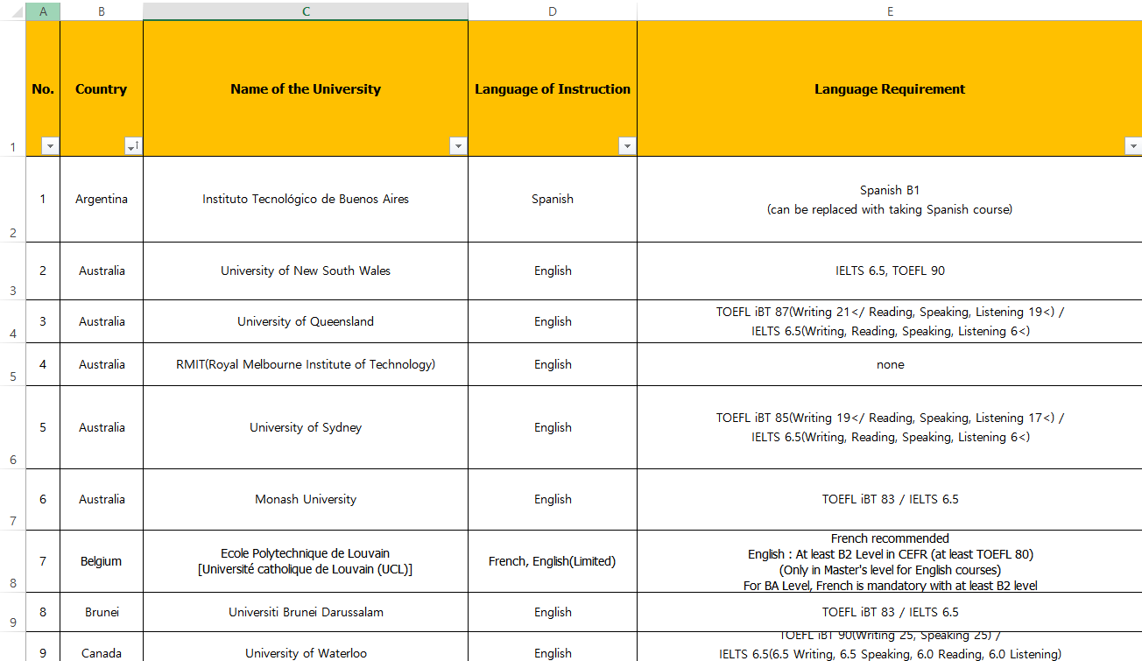
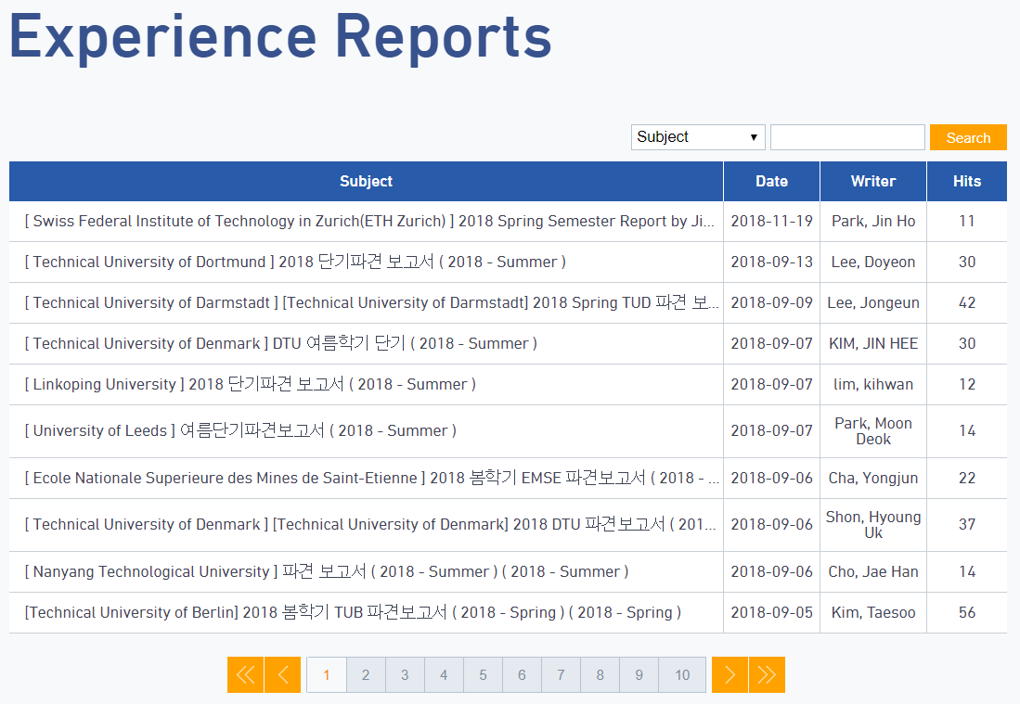
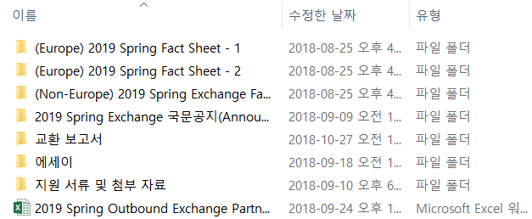
Why needed?
Information too fragmented!
Takes too much time to gather and overview

Slide 4
What if…
“Nupjuk Yi,
School of Computing,
Hopes to go to European university”
User information
Web UI
Display
Candidate partner universities
TO
Related departments
Language of instruction, prerequisite
Former exchange students’ reviews
KAIST IO manager of duty
Provided scholarship
Partner university DB
Providing immediate initial help for choosing partner university

Slide 5
Conceptual model (rough)
Attributes
Attributes
Attributes
IO manager
Partner university
Department (education track)
Scholarship
Former exchange student’s review
Language prerequisite
Attributes
Attributes
Attributes

Slide 6
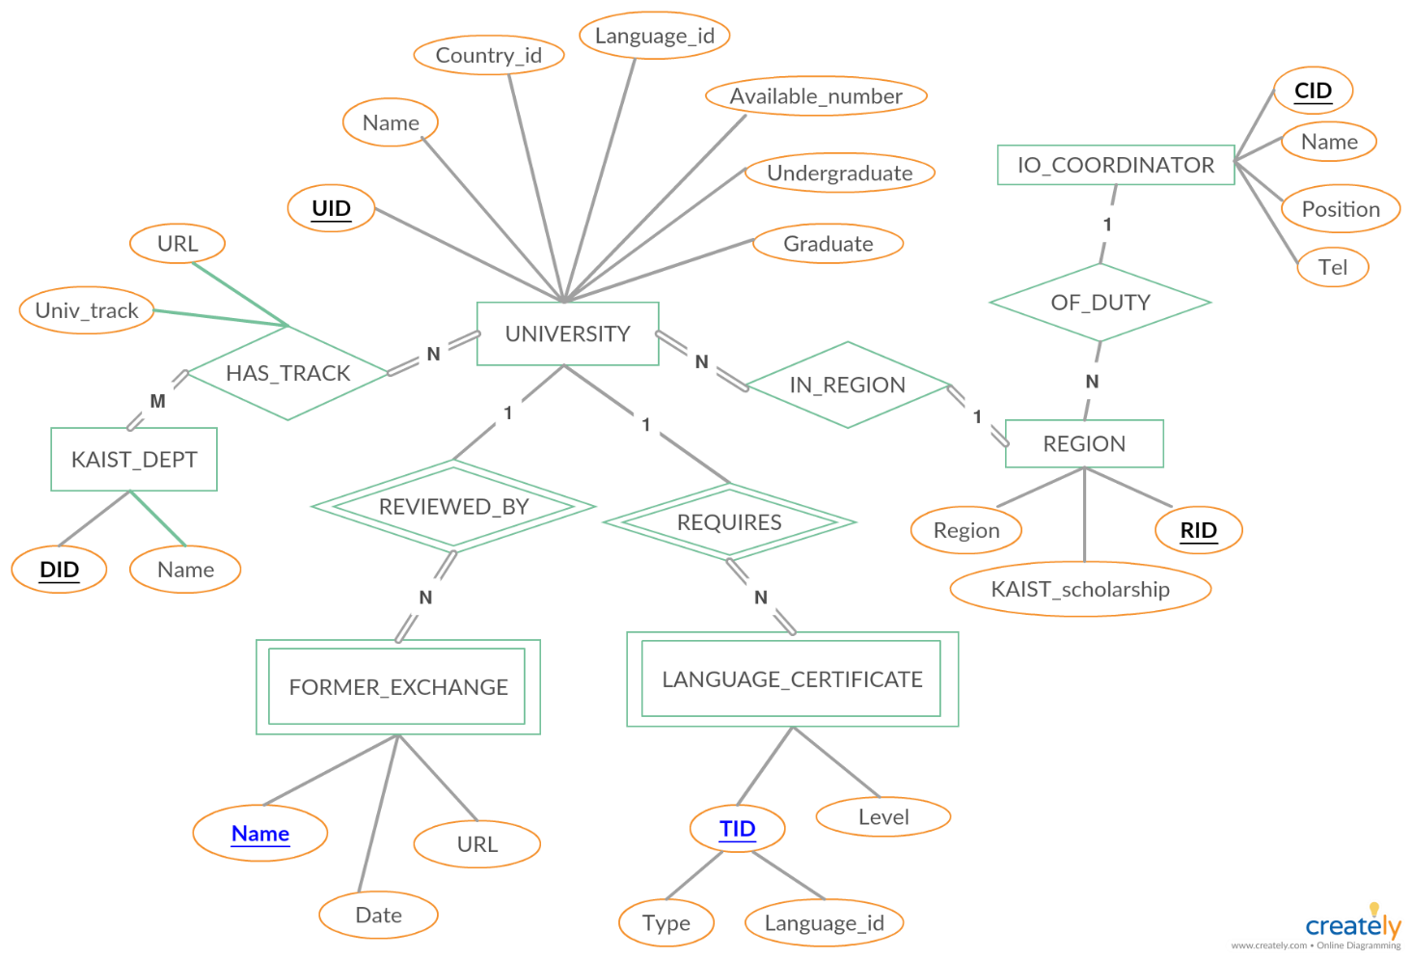
Conceptual model (ERD)
Primary key / Partial key

Slide 7
Relational schema
UNIVERSITY
UID | Name | Country_id | Language_id | Available_number | Undergraduate | Graduate | RID
REGION
IO_COORDINATOR
RID | Region | KAIST_scholarship | CID
CID | Name | Position | Tel
FORMER_EXCHANGE
LANGUAGE_CERTIFICATE
UID | Name | Date | URL
UID | Type | Language_id | Requisite
HAS_TRACK
KAIST_DEPT
UID | DID | Univ_track
DID | Name

Slide 8
Relational schema (FD: 2NF)
UNIVERSITY
UID | Name | Country_id | Language_id | Available_number | Undergraduate | Graduate | RID
REGION
IO_COORDINATOR
RID | Region | KAIST_scholarship | CID
CID | Name | Position | Tel
FORMER_EXCHANGE
LANGUAGE_CERTIFICATE
UID | Name | Date | URL
UID | Type | Language_id | Requisite
HAS_TRACK
KAIST_DEPT
UID | DID | Univ_track
DID | Name

Slide 9
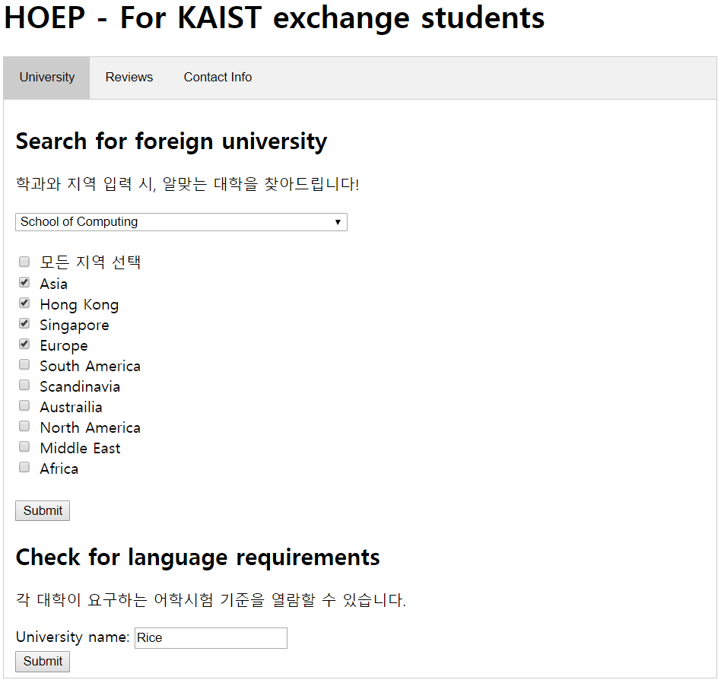
Time for actual demonstration…

Slide 10
Main function 1-1

Slide 11
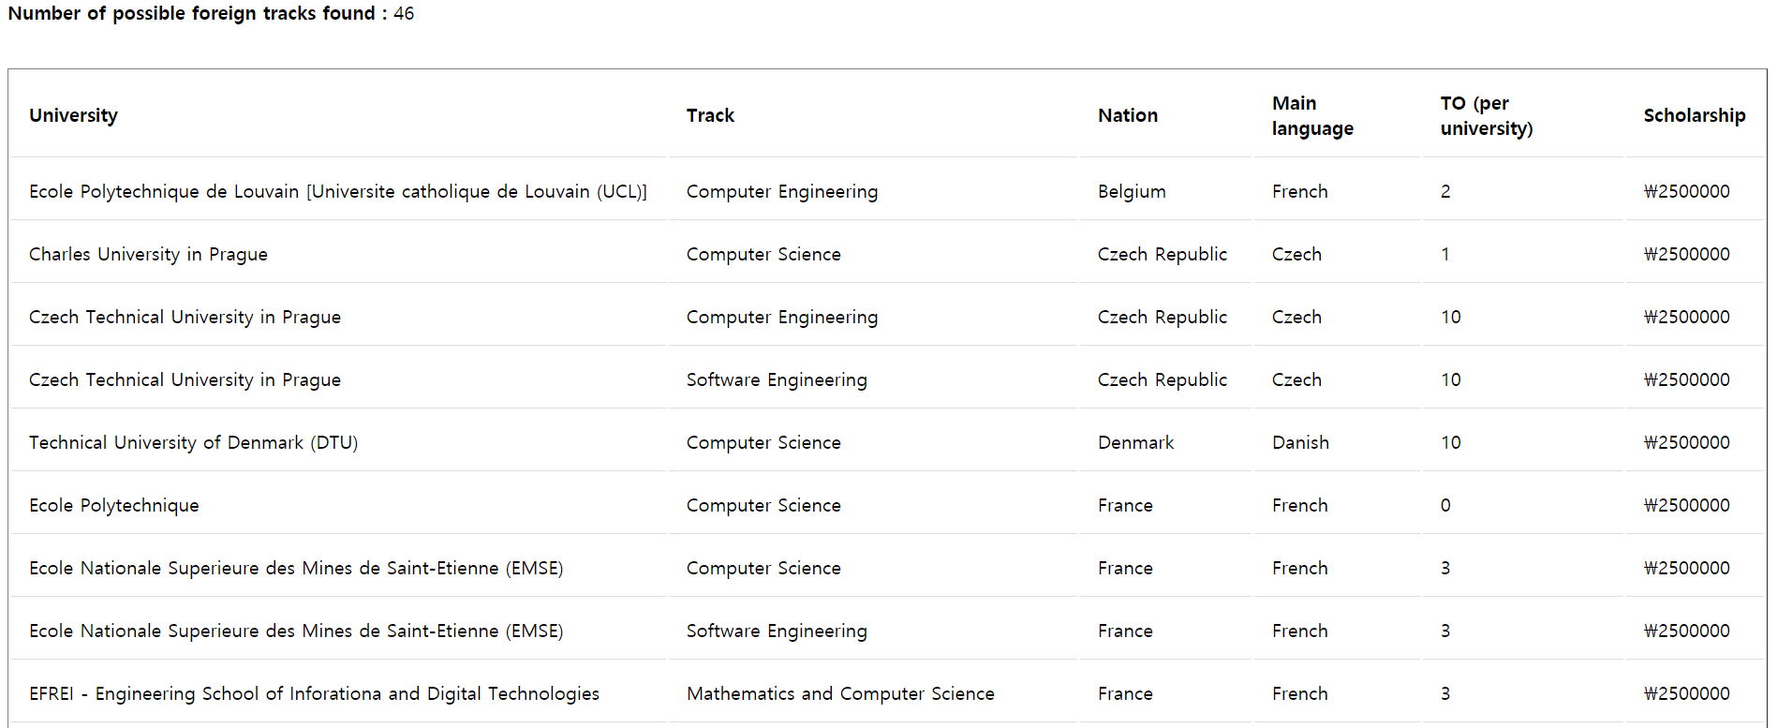
Main function 1-1
Total # of found tracks
University names
(may overlap)
Education tracks
Supplementary information

Slide 12
Main function 1-1
'SELECT A.Name as Univ_name, B.Univ_track as Dept,
A.Country_id, A.Language_id, A.Available_number, B.Scholarship
FROM UNIVERSITY AS A
INNER JOIN
(SELECT TRACK_N_UNIV.UID as UID,
TRACK_N_UNIV.Univ_track as Univ_track,
REGION.KAIST_scholarship as Scholarship
FROM (TRACK_N_UNIV INNER JOIN REGION USING (RID))
WHERE DID = ‘ + req.body.user_dept + ‘ AND RID IN ‘ + region_str_set + ’) AS B
USING (UID)
WHERE Undergraduate = 1;’
Subquery -> Main query
(Inline view)
Dept, region
condition given by
WHERE statement
“Open to undergraduates” condition given by
WHERE statement
Join by region
REGION
Scholarship info.
Projection
Univ name, track, country, language, TO, scholarship
HAS_TRACK
TRACK_N_UNIV
(View table)
Projection
UNIVERSITY
UNIVERSITY
Join by univ.
Join by univ.

Slide 13
Main function 1-2

Slide 14
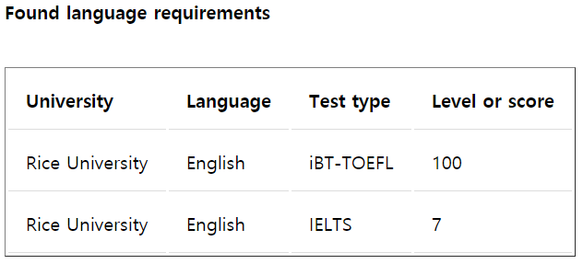
Main function 1-2

Slide 15
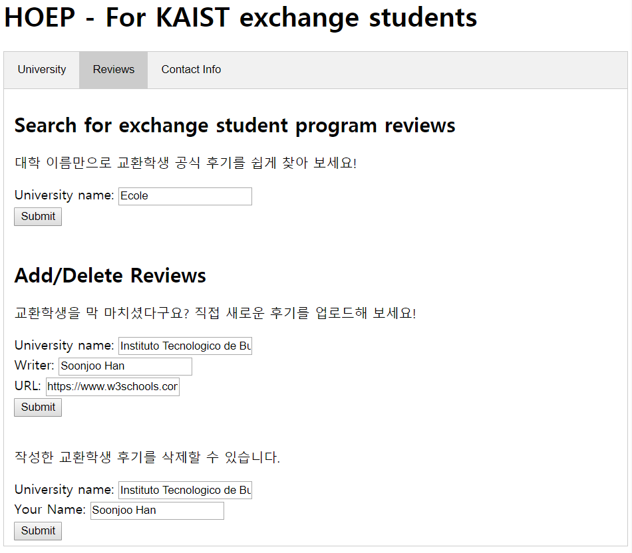
Main function 2-1

Slide 16
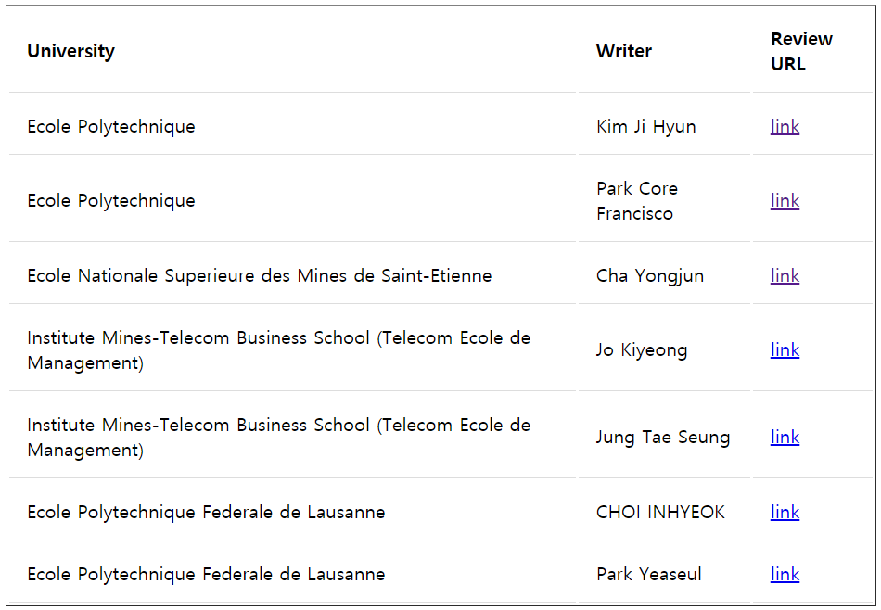
Main function 2-1

Slide 17
Main function 2-2

Slide 18
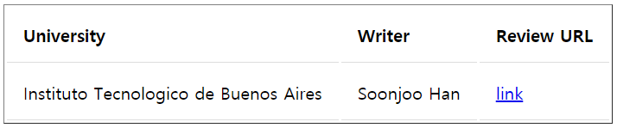

Main function 2-2

Slide 19
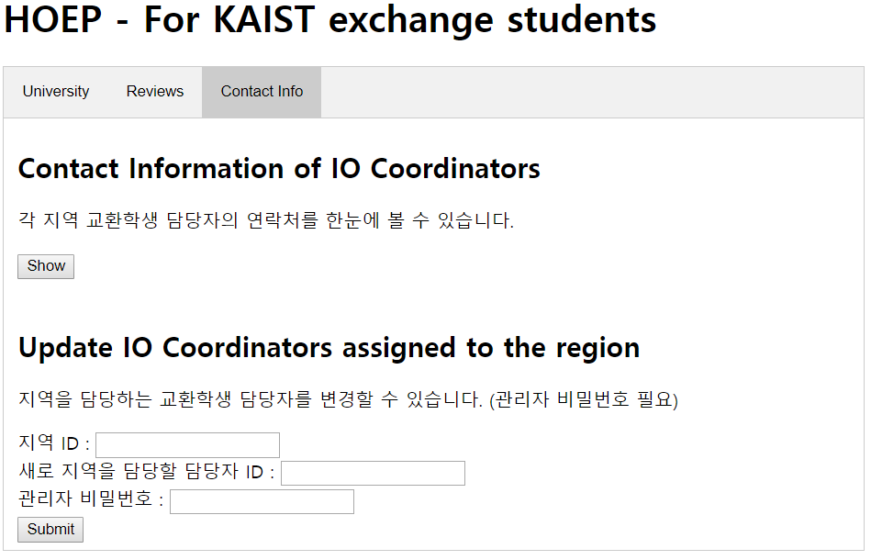
Main function 3-1

Slide 20
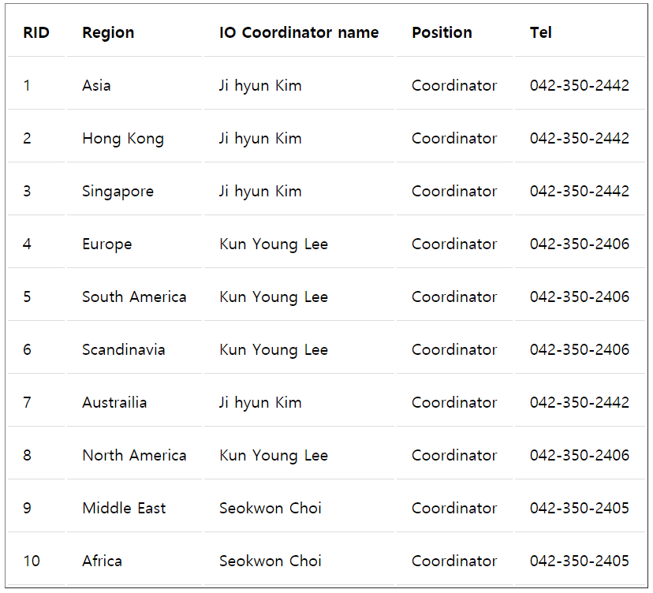
Main function 3-1

Slide 21
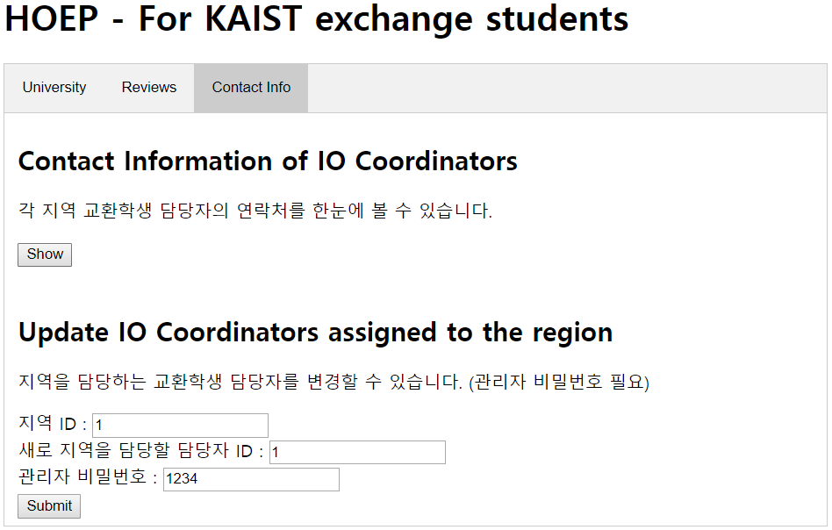
Main function 3-2

Slide 22
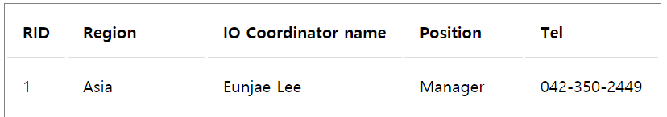
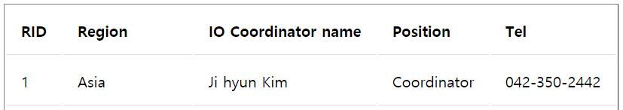
Main function 3-2

